Slide 1
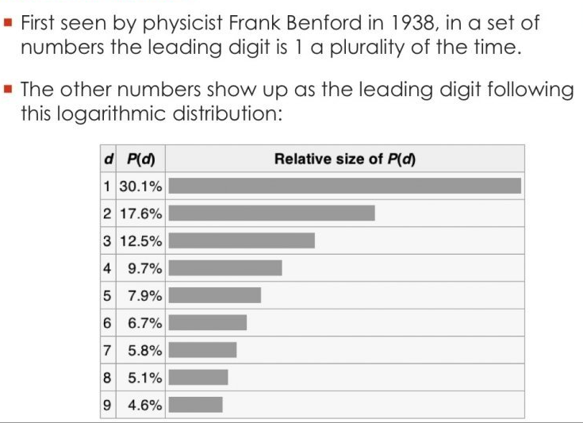
The number 1 appears as the first digit 30% of the time in real world numbers

Slide 2
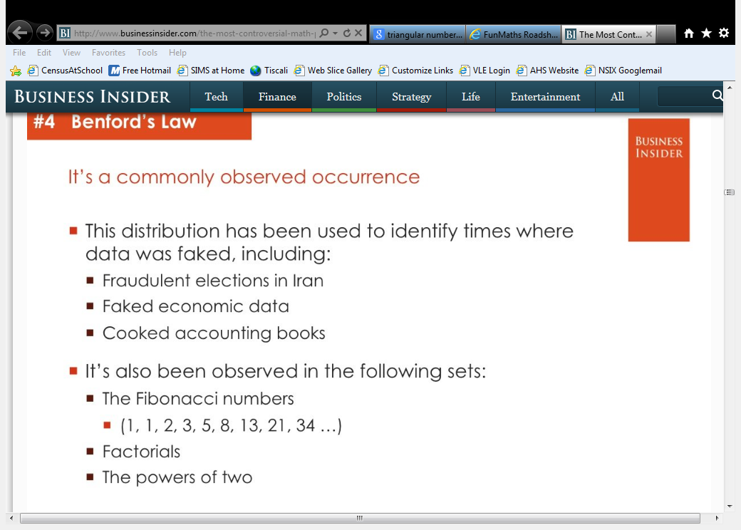
Isn’t that just great!

